Slide 1

Fabulous Journey of an Architect

Slide 2
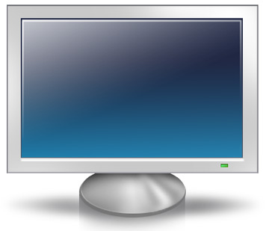
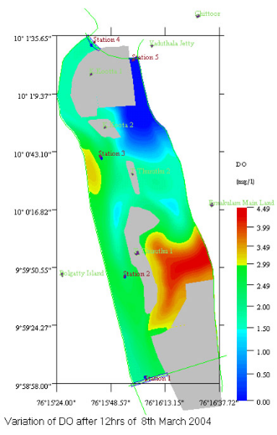

PolSoft
Reporter
Result Data
Data in .dat / .txt format
Input Parameters
Data in .dat / .txt format
Application
VC++/MFC, OpenGL, OLE, COM
(Integrated Components)
Solver
C, Fortran
(Numerical equations / CFD Algorithms)

Slide 3
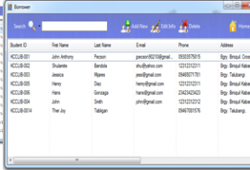

LibSoft
e-Institute
Distributed Components
VB / ActiveX
(Common Components for all the applications)
MS SQL / Oracle
Application
VB, ActiveX, COM
(Desktop / Intranet)
Servlet
Java
(Components Hosted in Tomcat)
Breeze

Slide 4
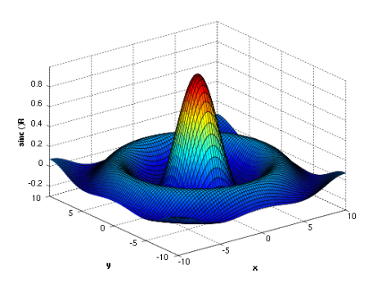

Systat
Graphics Engine
VC++/MFC, OpenGL, DirectX, GDI+, COM
(Components as per Grammar of Graphics)
StatCAPI
Parser
C, C++
(Data in the form of Expression / Equation / csv)
Systat / SigmaPlot
VC++/MFC
(Integrated Components)
Numerical Engine
C, C++
(Numerical equations / Statistical Algorithms)

Slide 5





Graphics Engine
Canvas
Plot
GDI+
Trans
Axis
Data
Scale
Grammar of Graphics
Legend
Graph
(Data structure to hold all the elements)
Title
Coord
Guide
Element
Annotation
Geometry

Slide 6
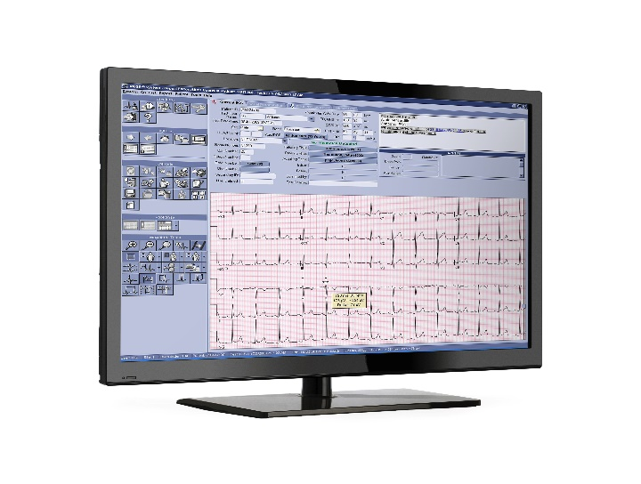
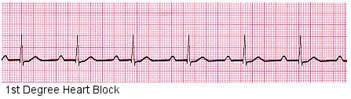
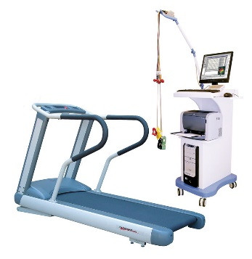
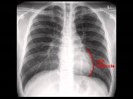

Cardiovascular - Stress ECG
Cerner DB
CCL/SQL
(CCL-Cerner Command Language, Scripts, Schema)
Application Services
(Java / C++)
Cardiovascular Module
C++, VC++/MFC, COM
(Components having Data Manager, Viewer Factories)
Powerchart
(Host Application for Cardiovascular modules)
CAMM
(Imaging Archive for ECG, XRays, MRI, CT)

Slide 7
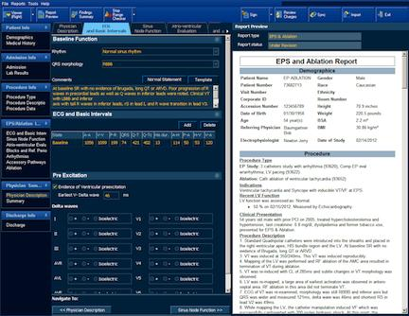
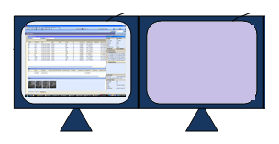


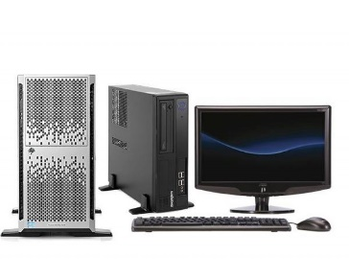

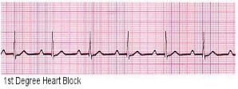
Cardiovascular - Cath / Hemo Skyvue Integration
Reporting
System
Report Module through SkyVue
Diagnostic Viewer through SkyVue
Hemo
System
Cath Lab
Server
COM Interface
(C++ / MFC / COM)
Webservice
Java/J2EE
(for Reports)
Cardiovascular Module
C++, VC++/MFC, COM
(Components having Data Manager, Viewer Factories)
Vascular
Server
Skyvue
Java
Nuclear
Server
Cerner DB
CCL/SQL
(CCL-Cerner Command Language, Scripts, Schema)
CAMM
(Imaging Archive for ECG, XRays, MRI, CT)
Application Services
(Java / C++)
Third Party Stack

Slide 8
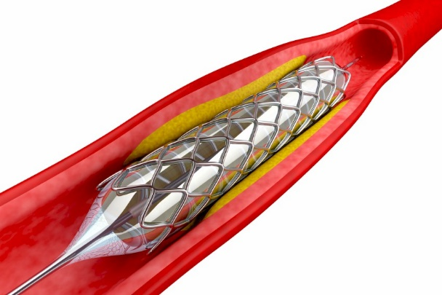
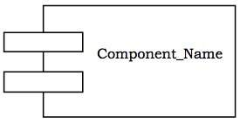
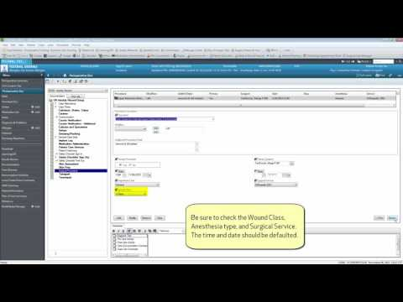
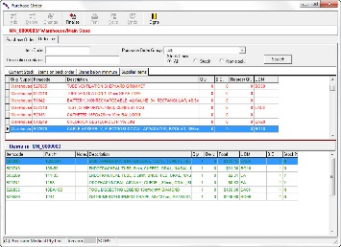
Surgery - Tissue/Implant Integration
Tissue Interface
Tissue Data Model
C#
Supply Chain
(Tissue / Implants dispensed)
Surgery Module
C#, VC++/MFC, Interop
(Winforms)
SurgiNet
(Surgery Application for clinical documentation)
Application Services
(Java / C++)
Implant Data Model
Implant Interface
C++
Cerner DB
CCL/SQL
(CCL-Cerner Command Language, Scripts, Schema)
Powerchart
(Host Application for Implant History Views)
FHIR Services
(Java, JSON / XML)

Slide 9

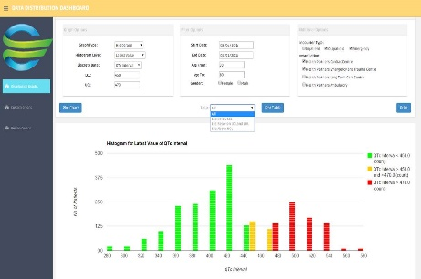










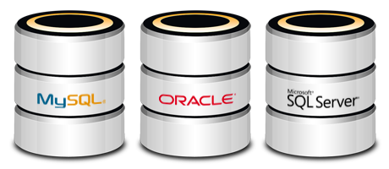





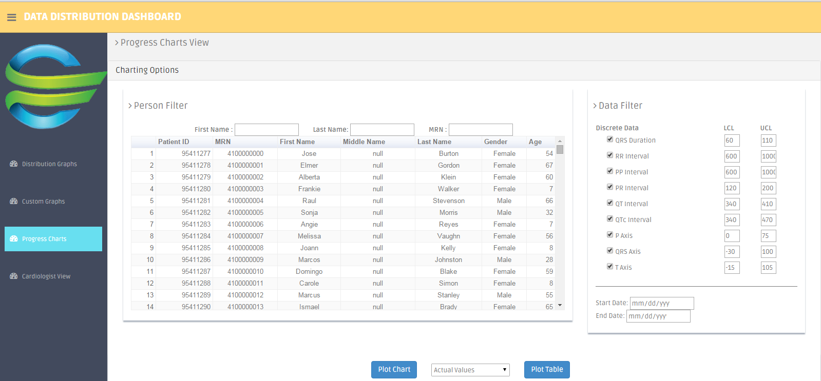
Cardiovascular Risk Dashboard
Analyzer
Clinical DB
Pop Health
OPMA DB
Health Facts
Data Manager
Crawler
Client

Slide 10


